Slide 1
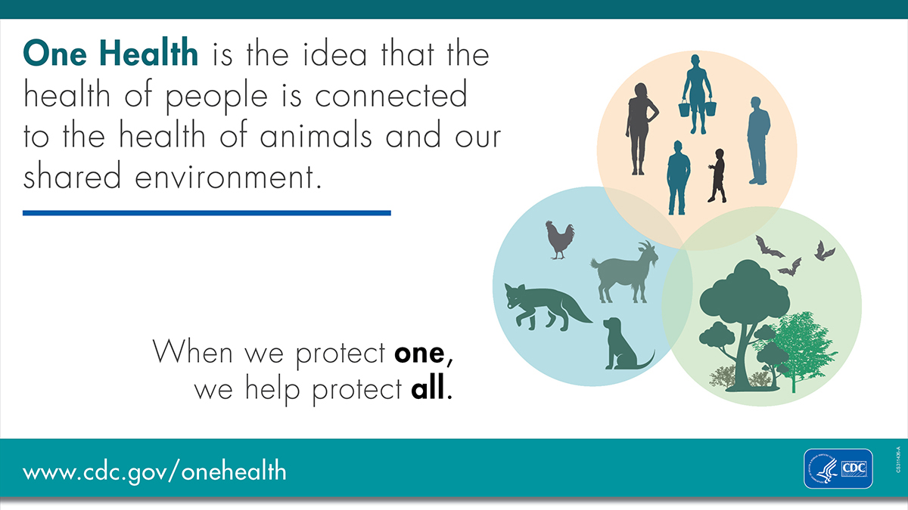






Trees Ease Disease: Forest Conservation as a Public Health Tool
Amal Dadi
The Organization
Mission: Dogwood Alliance advances environmental justice and climate action by mobilizing diverse voices to protect southern forests and communities from industrial logging
My Approach
Project Components
Key Findings
OneHealth Overview
Analyzing the framework and its possible applications to forest advocacy
Potential for coalition-building; using One Health to create and strengthen relationships with interest groups not traditionally focused on environmental conservation
Findings
Literature Review
Collecting resources and information on intersections between forest health and human health
Published literature indicates that forests have a variety of beneficial impacts on population health, nutrition, and lifestyle. These effects are incredibly consistent across cultures and continents
Framing Questions
Existing Policy
Compiling examples of legislation that have been introduced domestically or internationally
New Jersey is a domestic leader, recently creating a One Health task force for cross-disciplinary and inter-agency coordination. International legislation and policies vary in form and scope
How do we effectively communicate about connections between human and environmental health?
How does environmental advocacy intersect with public health?
Health Outcomes
Using publicly available datasets to analyze health of communities near forests, logging, or biomass plants
Communities near forested greenspace have significantly better outcomes for a variety of conditions, including COVID-19, respiratory illness, cardiovascular disease, cancer, and mental health
What health benefits do forests provide and what health risks are associated with their degradation?
Acknowledgements
Many thanks to: Dr. Sam Davis, Denzel Burnside, and Dr. Lucia Ibarra at Dogwood Alliance; Dr. Nishad Jayasundara at the Nicholas School of the Environment; Duke students and Dogwood Fellows Michelle Thompson and Yuna Oh; Michael Waitzkin, Dr. Misha Angrist, and Dr. Janet Malek at Science & Society
What are the policy priorities in this space?

